Slide 1

Moffat Bay Island Marina
By Group 2.

Slide 2
Goals and Purpose
The purpose of this document is to outline the technical design and development plan for the Moffat Bay Island Marina website.
The website will allow customers to view marina information, register, log in, reserve long-term slips based on boat size, and manage their reservations. It will also include functionality for waitlists when slips are unavailable.
This document will serve as a blueprint for the development, testing, and deployment of the website.
The goal is to create an easy to access Marina website that allows any user to book a slip with zero hassle along with creating a backend that will allow for easy management of the reservations.

Slide 3
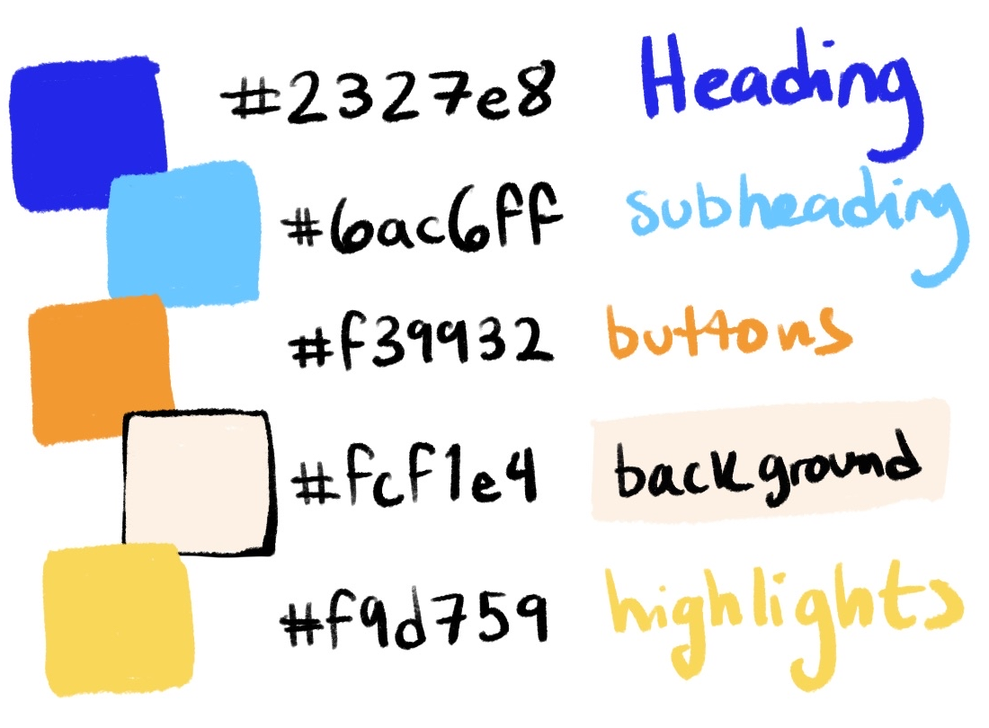
Color Scheme
The goal for the overall color scheme is to have a different feal from other Marinas while still being inviting and welcoming to those who are visiting our site.
These colors will compliment each other well and be distinct enough from one another that users should be able to identify the various elements by color alone.

Slide 4
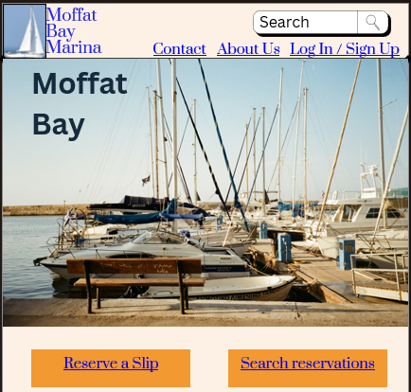
Landing Page

Slide 5
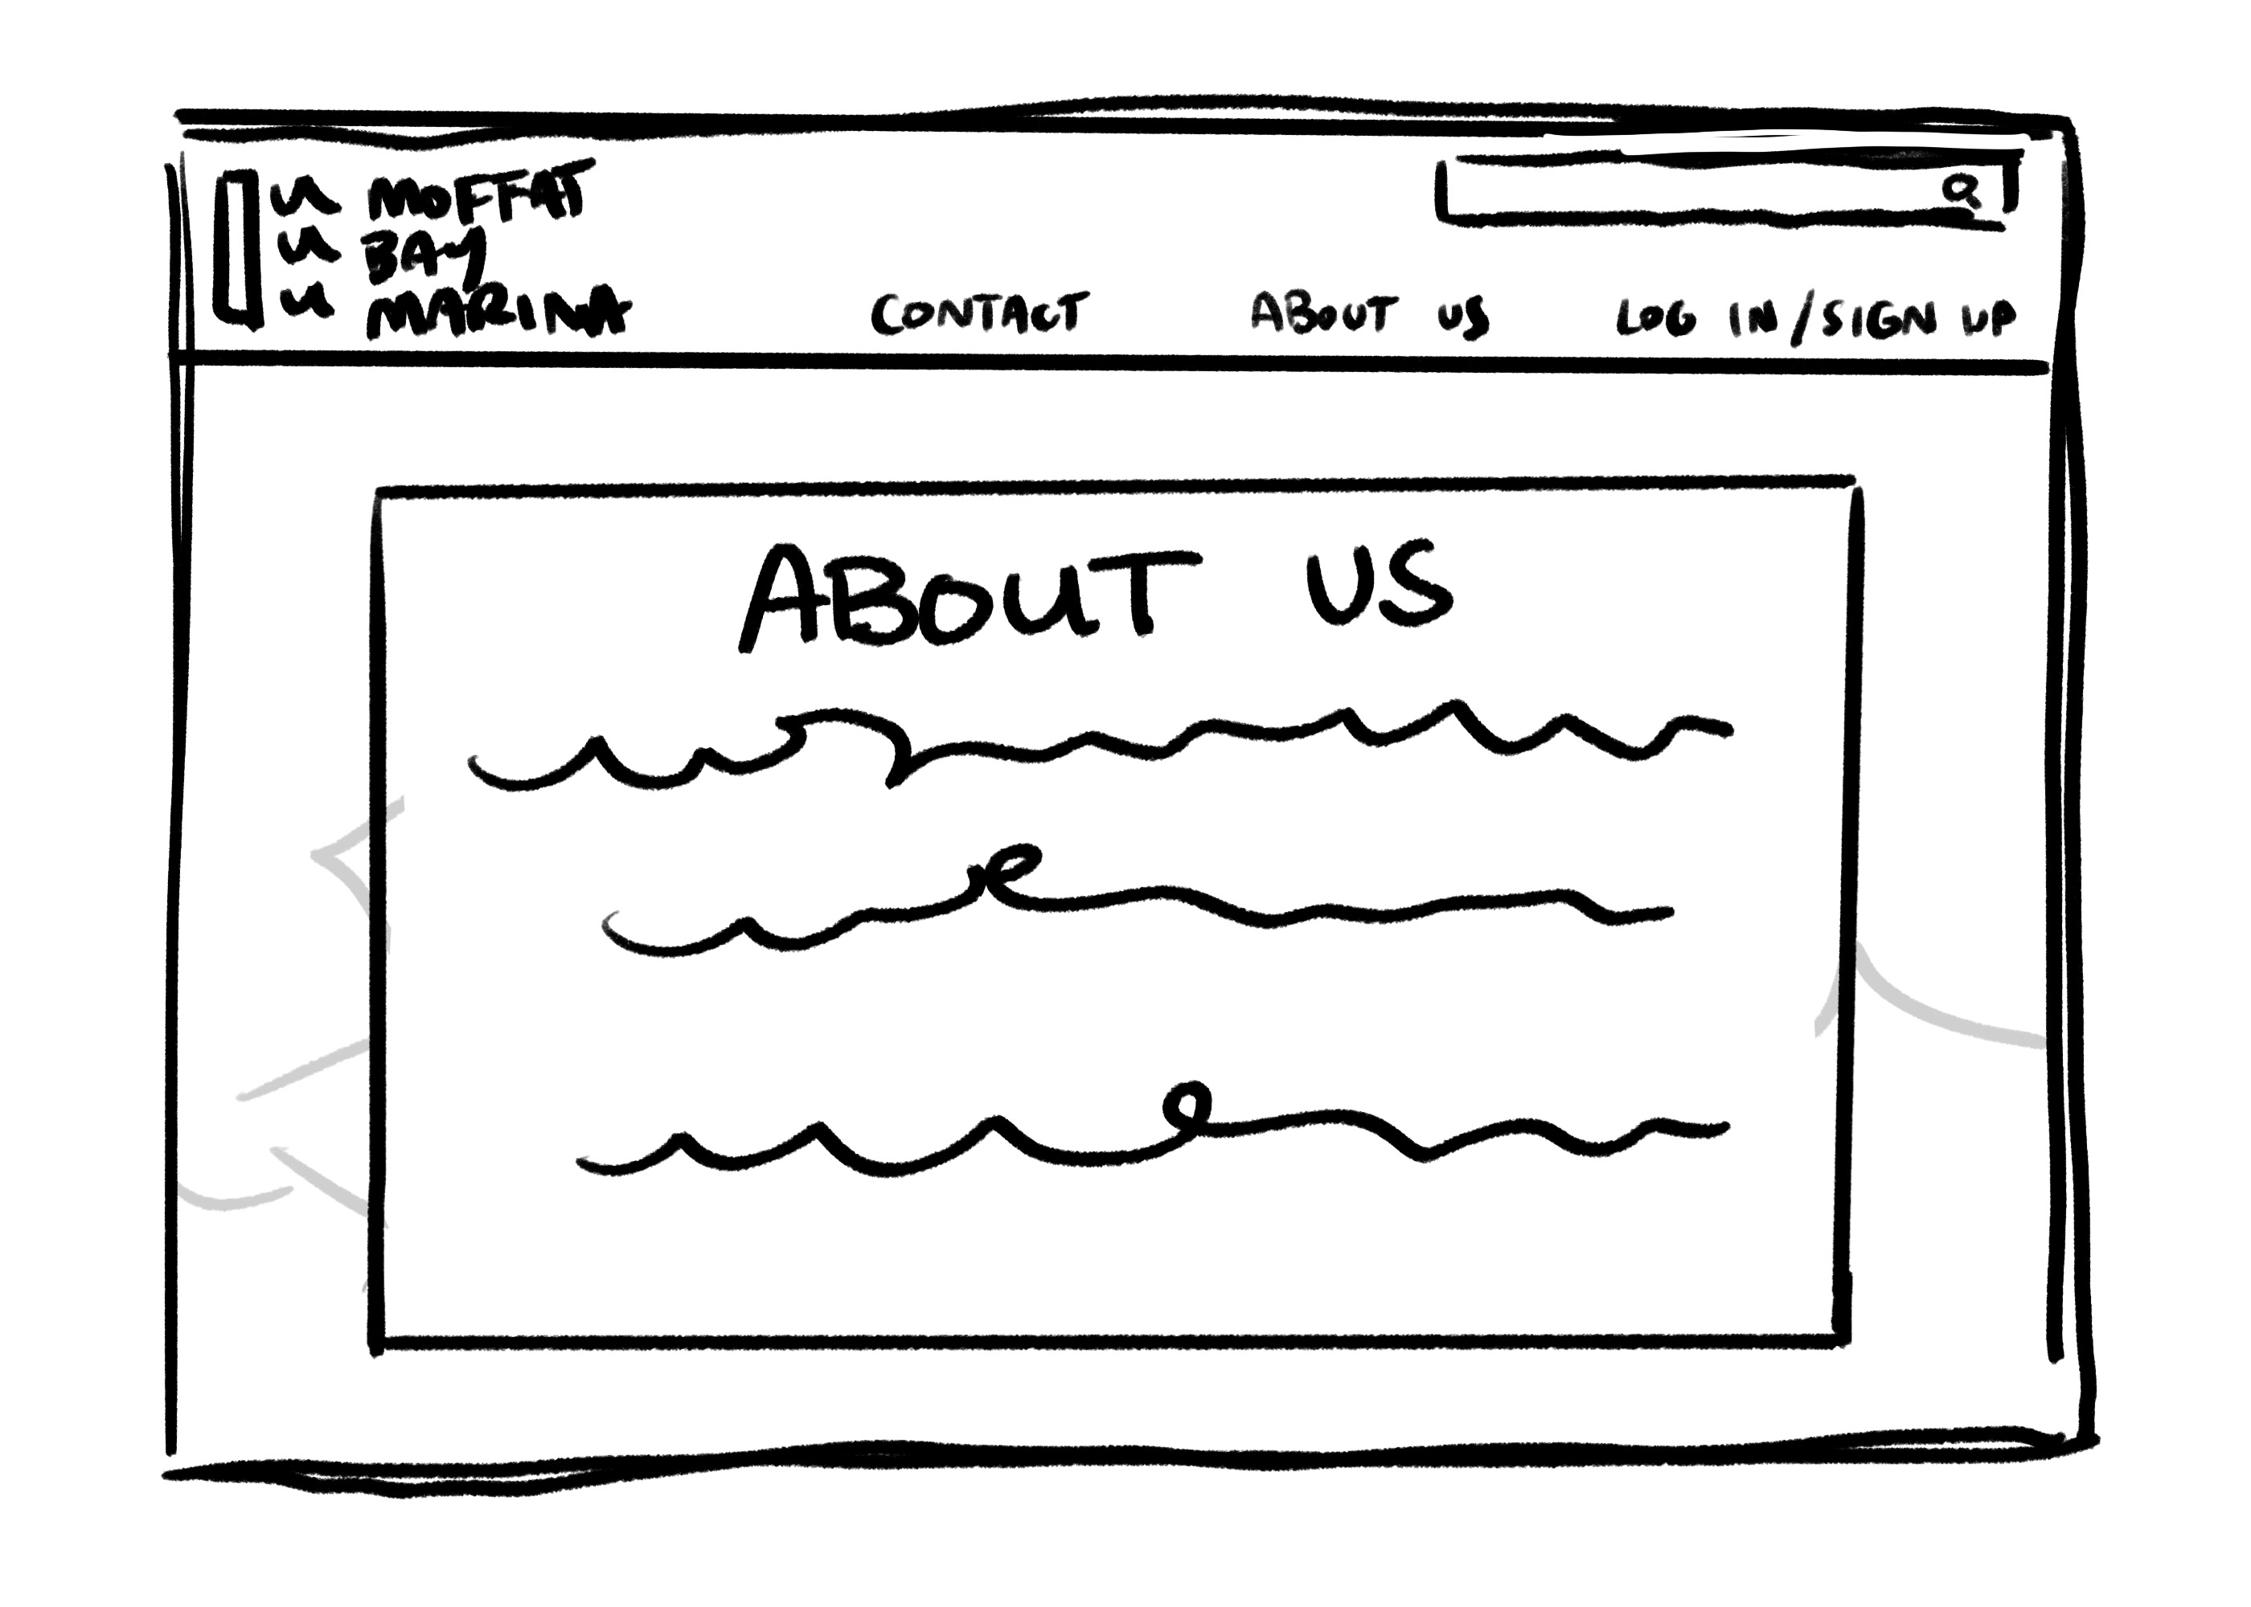
About Us Page

Slide 6

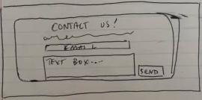
Contact Us Page

Slide 7
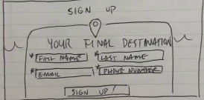
Register Page

Slide 8
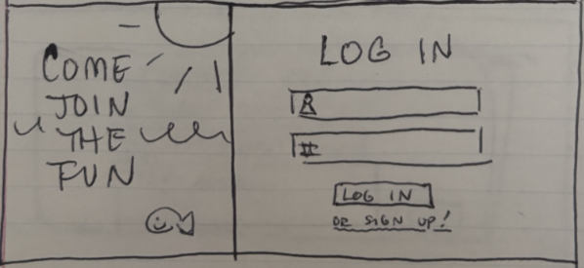
Login Page

Slide 9
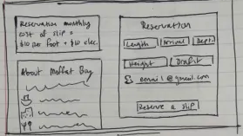
Reservation Page

Slide 10
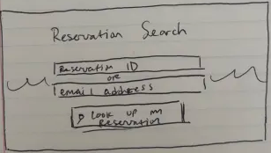
Reservation Lookup

Slide 11

Wait List Page

Slide 12
Timeline For Completion & Estimated Cost
4 Weeks for completion of First pass on website.
1 Weeks of QA
1 week for revisions post testing
$5000 for server setup and development costs.
INITIAL DEVELOPMENT
QA/TESTING
REVISION

Slide 13

What Do You Say?
Our team has combined years of experience working within the web development field and will serve you with not only a clean and easily accessible website but will do so in a timely manor.
We have plenty of past work to point to if interested and will ensure you are included thru out the development cycle.

